Slide 1
Tutorial Material
Deep Nets
Pretraining
Fine-Tuning
Inference
GNNs (Graphical Neural Nets)
Linear Algebra
SVD (Singular Value Decomp)
Latent Semantic Indexing
Spectral Clustering

Slide 2
Standard 3-step recipe ACL-2022 Tutorial
Pre-training
Fine-tuning
Inference

Slide 3
Standard 3-Step Recipe
Step | Description | Time | Hardware
1
2
3 | Inference | Seconds/Minutes | 0+ GPUs
Easy

Slide 4
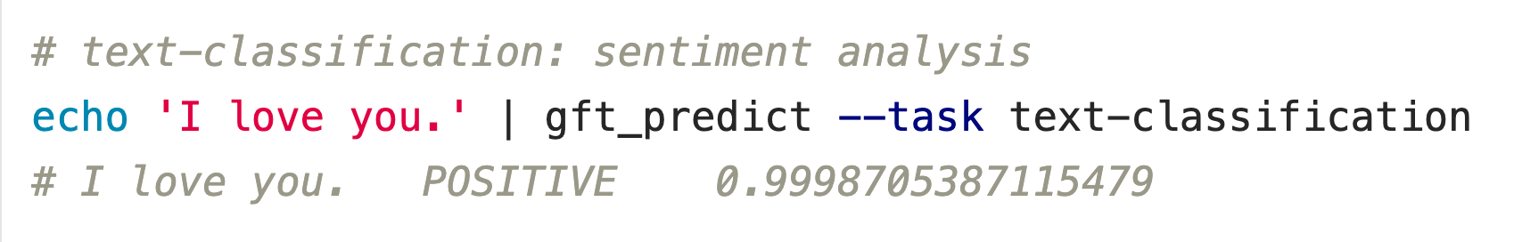


Inference: f(x) → y
Score
https://github.com/kwchurch/ACL2022_deepnets_tutorial

Slide 5



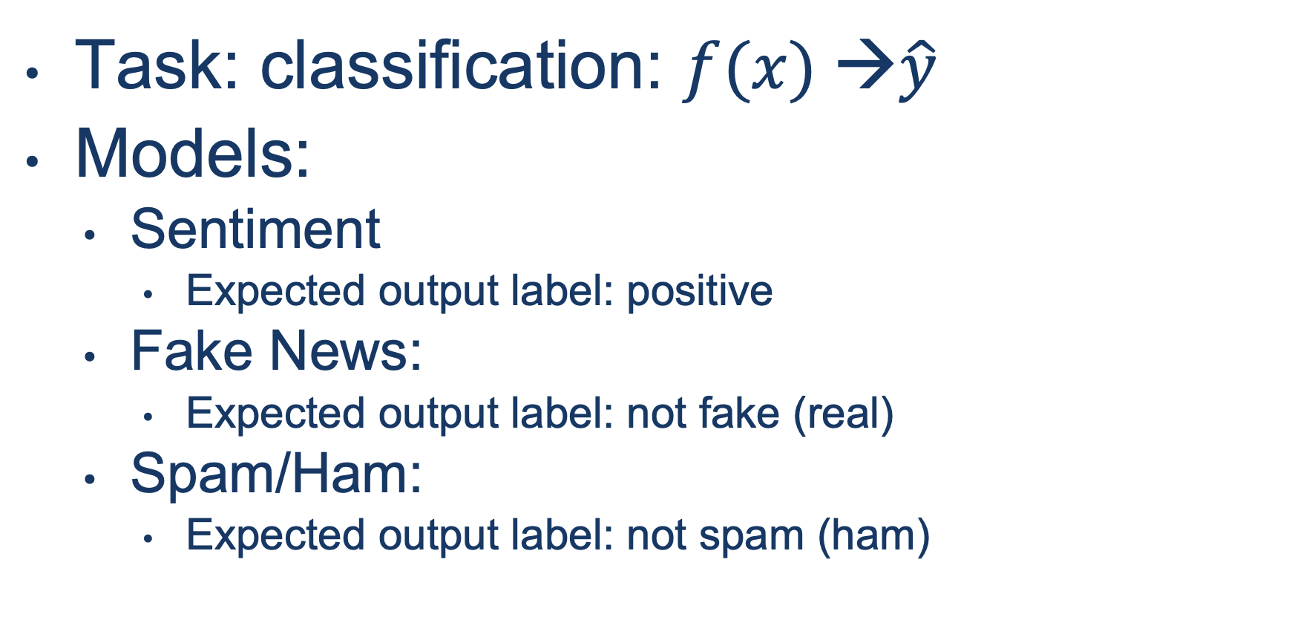
Input: I love you Output: Depends on Model: $f$
Task: classification: $f(x) →\hat{y}$
Models:
Sentiment
Expected output label: positive
Fake News:
Expected output label: not fake (real)
Spam/Ham:
Expected output label: not spam (ham)

Slide 6
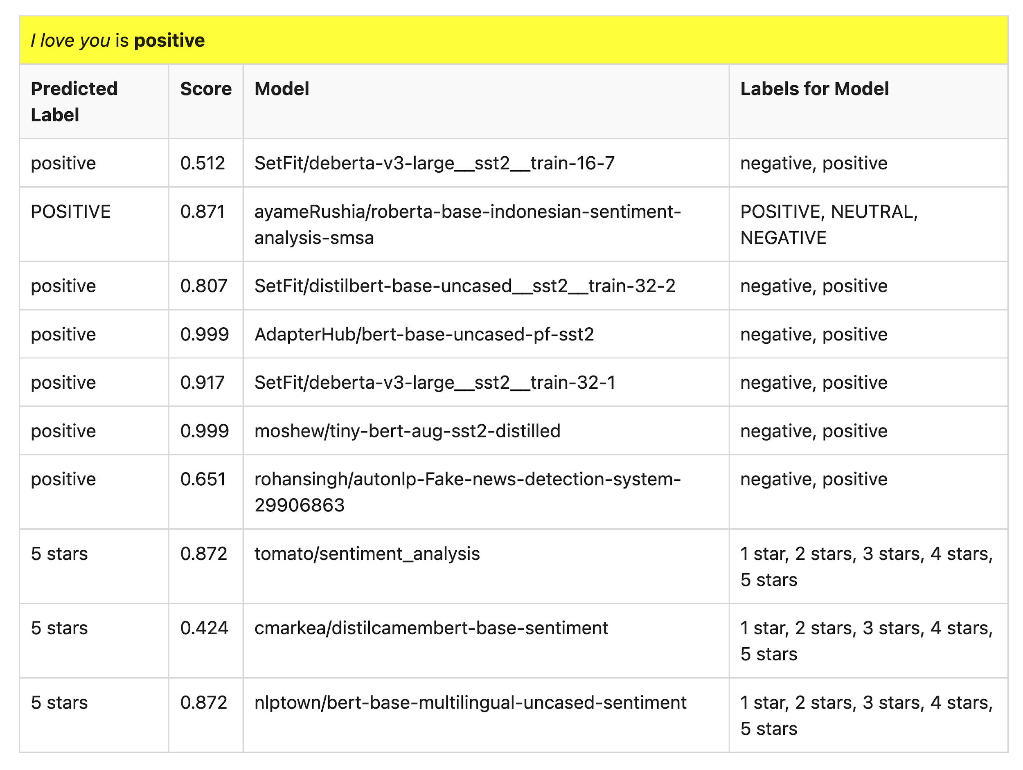
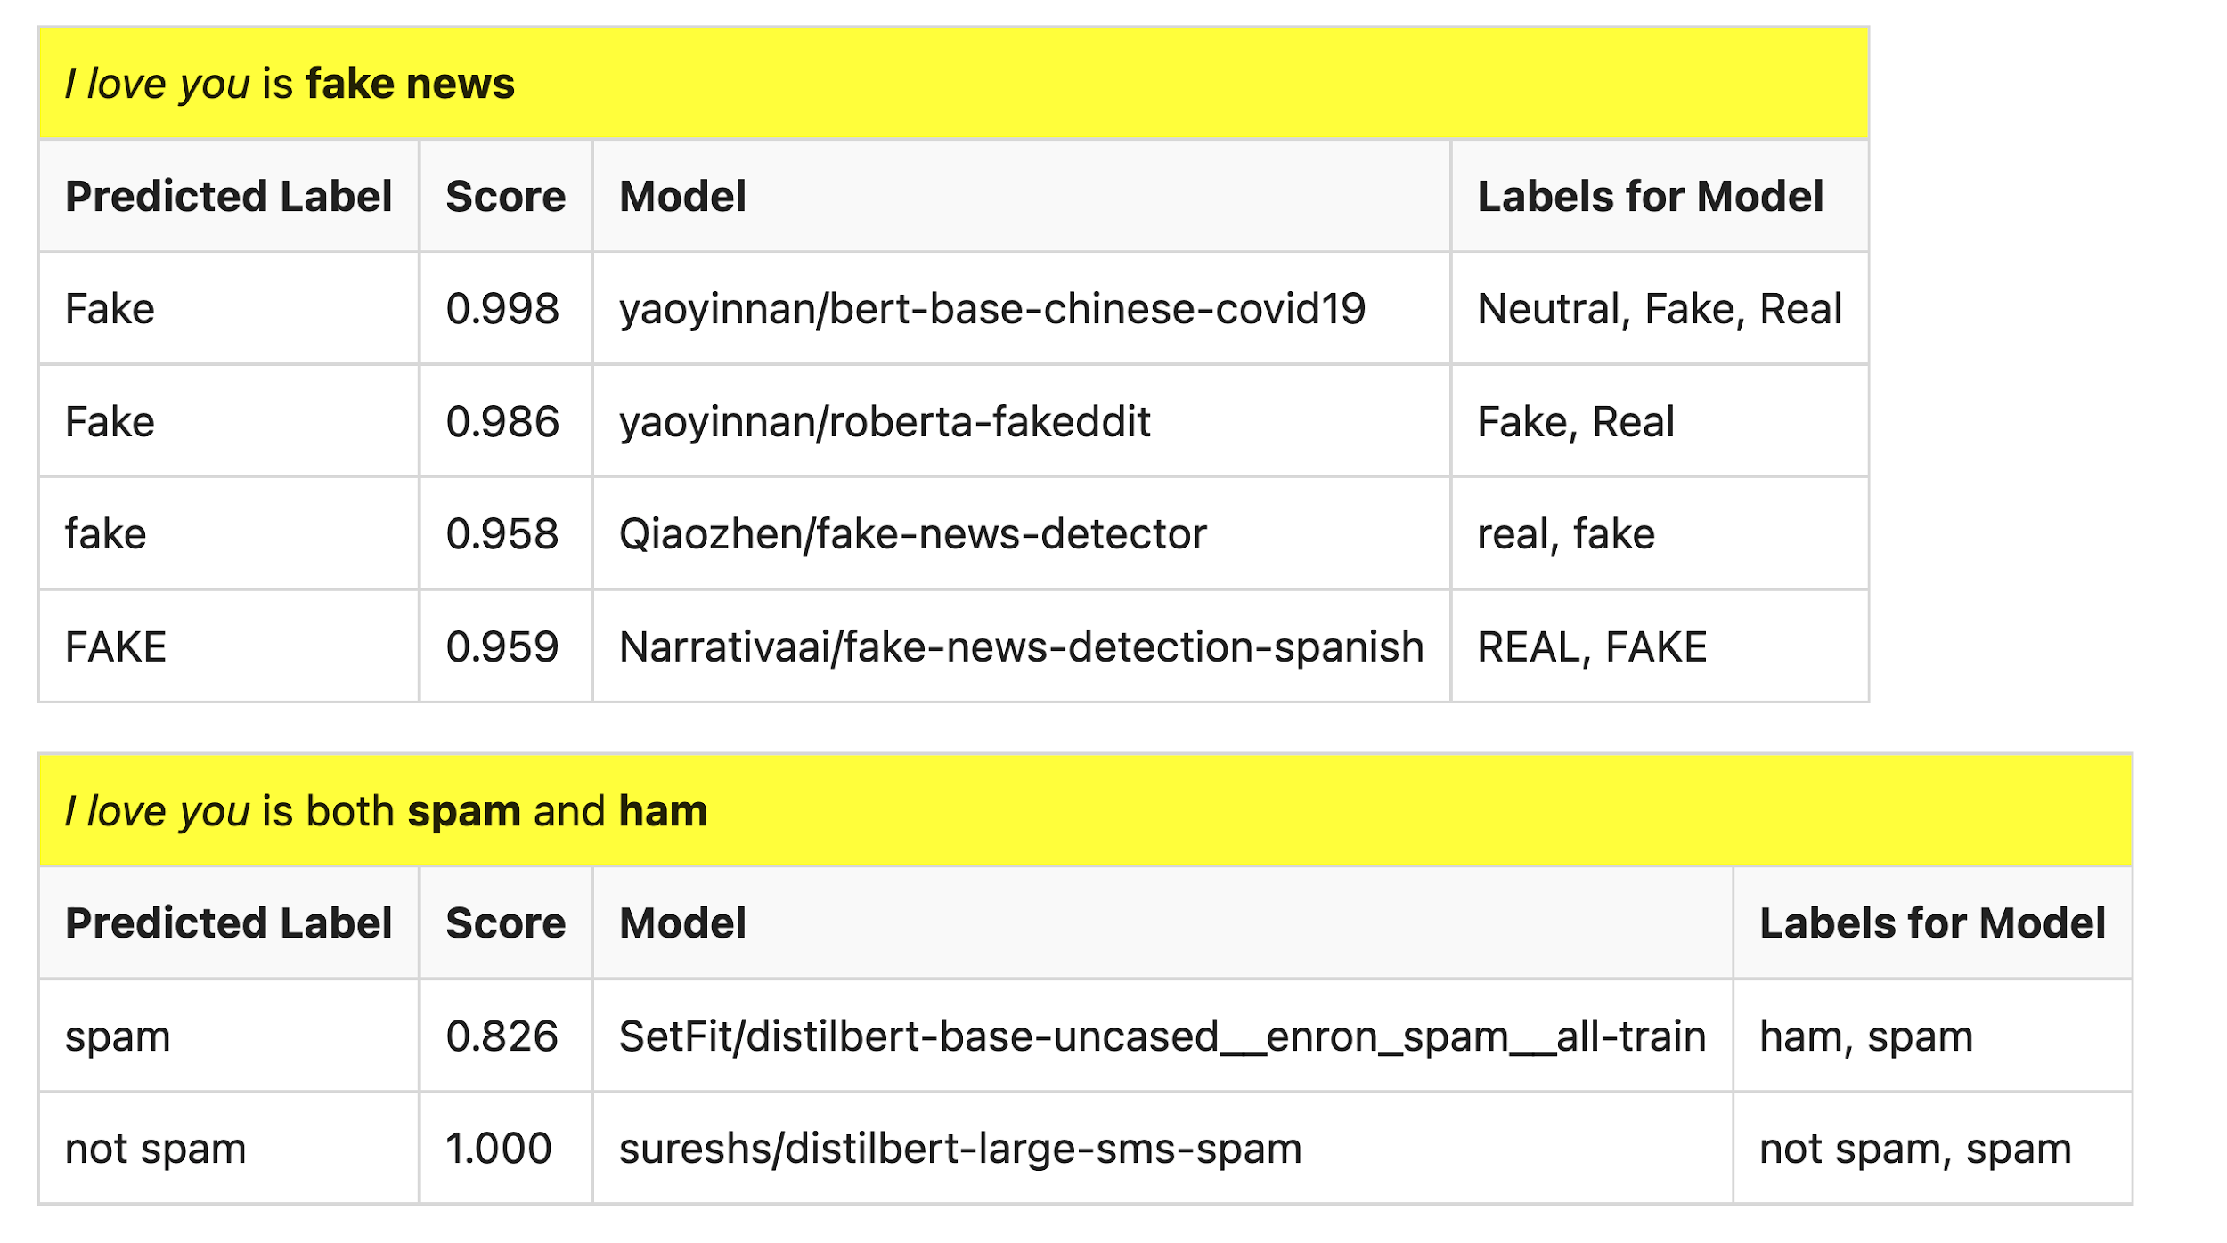
Many of these models produce reasonable results
Scores could be more confident

Slide 7

Lots of Models on Hubs (for lots of tasks)
Natural Language
Classification
Sentiment: positive/negative, 1-5 stars
Emotion classification
Hate speech classification
Guess missing word (fill-mask; cloze task)
Part of speech tagging
NER (named entity recognition)
Question Answering (SQUAD)
Entailment (GLUE)
Image Classification
Speech recognition
Machine Translation
Examples of fill-mask
echo … | gft_predict --task fill-mask
I <mask> you
miss|0.295
love|0.174
salute|0.158
I love the <mask> guy
pizza|0.035
funny|0.016
old|0.010
Examples of machine translation
echo …| gft_predict --task translation \
--model H:Helsinki-NLP/opus-mt-en-fr
I love you
Je t'aime.
2k translation models
on HuggingFace

Slide 8
Standard 3-Step Recipe
Most users should not do this themselves
Step | Description | Time | Hardware
1 | Pre-Training | Days/Weeks | Large GPU cluster
2
3 | Inference | Seconds/Minutes | 0+ GPUs

Slide 9
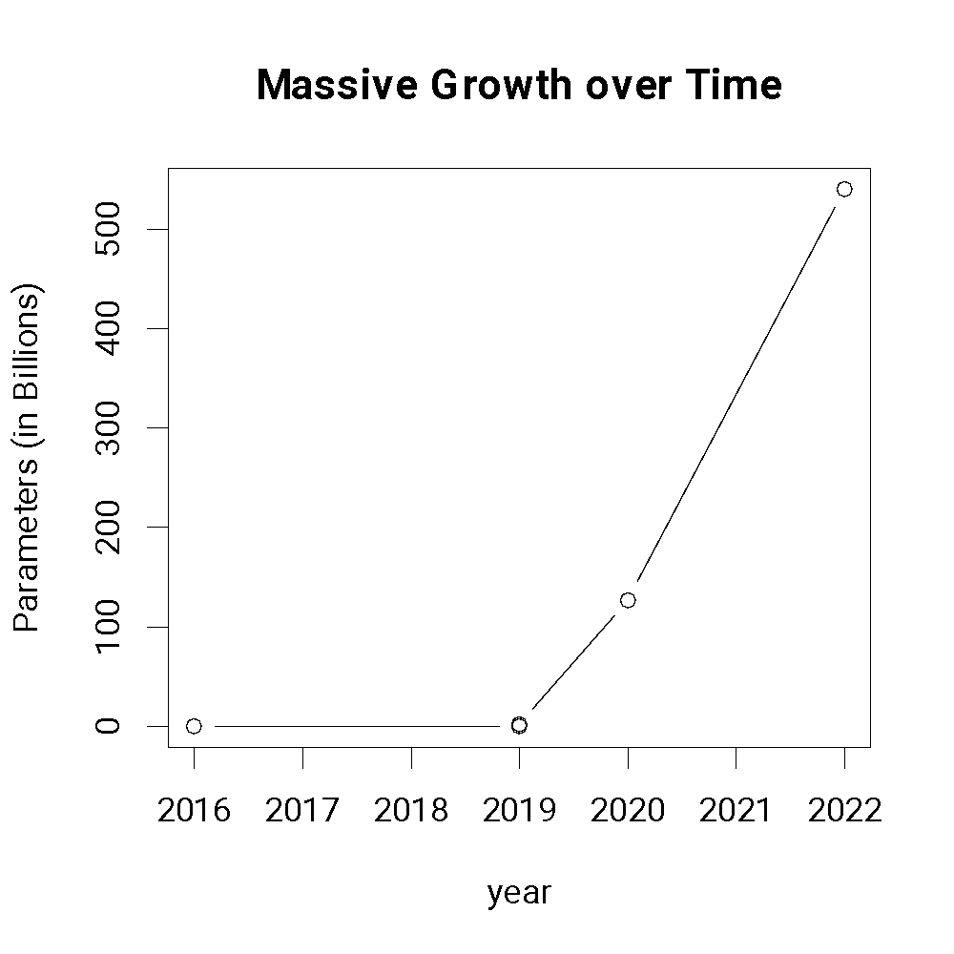
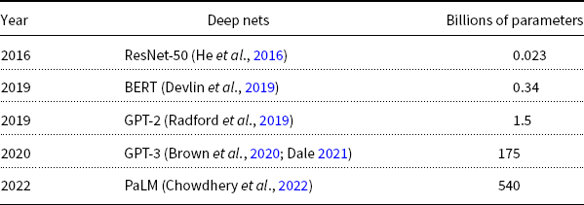
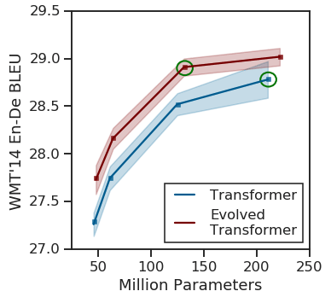
Most users should not invest in pretraining because growth (& costs) are out of control
A Rising Tide
Lifts All Boats

Slide 10
Standard 3-Step Recipe
Step | Description | Time | Hardware
1 | Pre-Training | Days/Weeks | Large GPU cluster
2 | Fine-Tuning | Hours/Days | 1+ GPUs
3 | Inference | Seconds/Minutes | 0+ GPUs
Not Hard

Slide 11

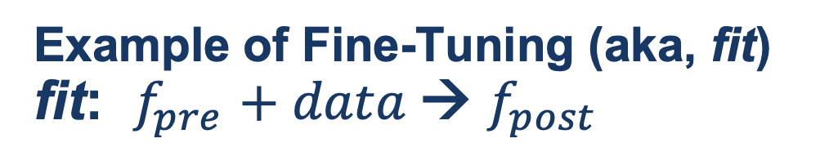
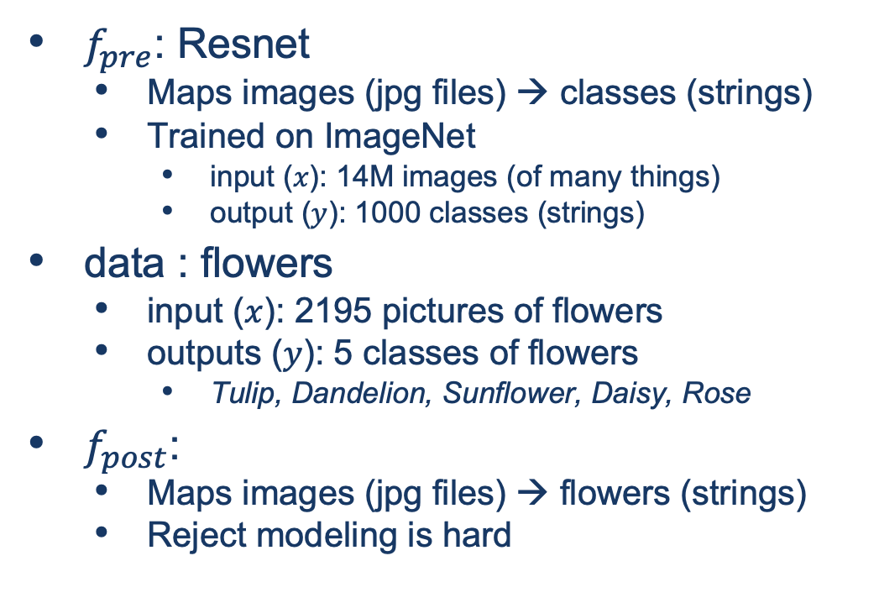
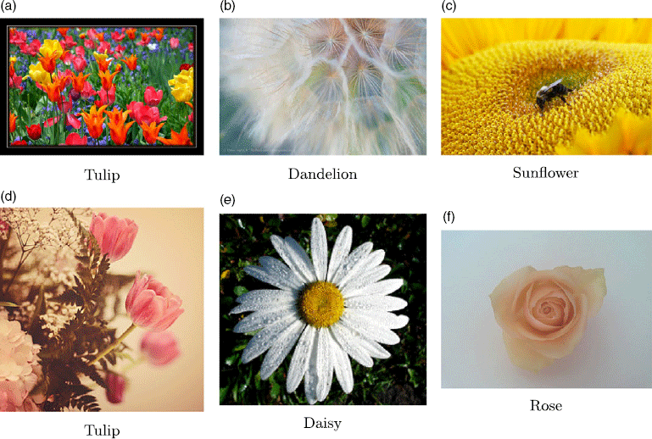
Guide Book App

Slide 12
Tutorial Background
Metcalfe’s Law
Deep Nets
Pre-training
Fine-Tuning
Inference
Specter
GNNs
Approximate Nearest Neighbors
Graphs
Random Walks
Shortest Paths
Linear Algebra
SVDs
Latent Semantic Indexing
Laplacians
ProNE

Slide 13


GNN Alternative
Black Box
GNN
Embeddings
$$M∈ℝ^{N×K}$$
Text
Context

Slide 14

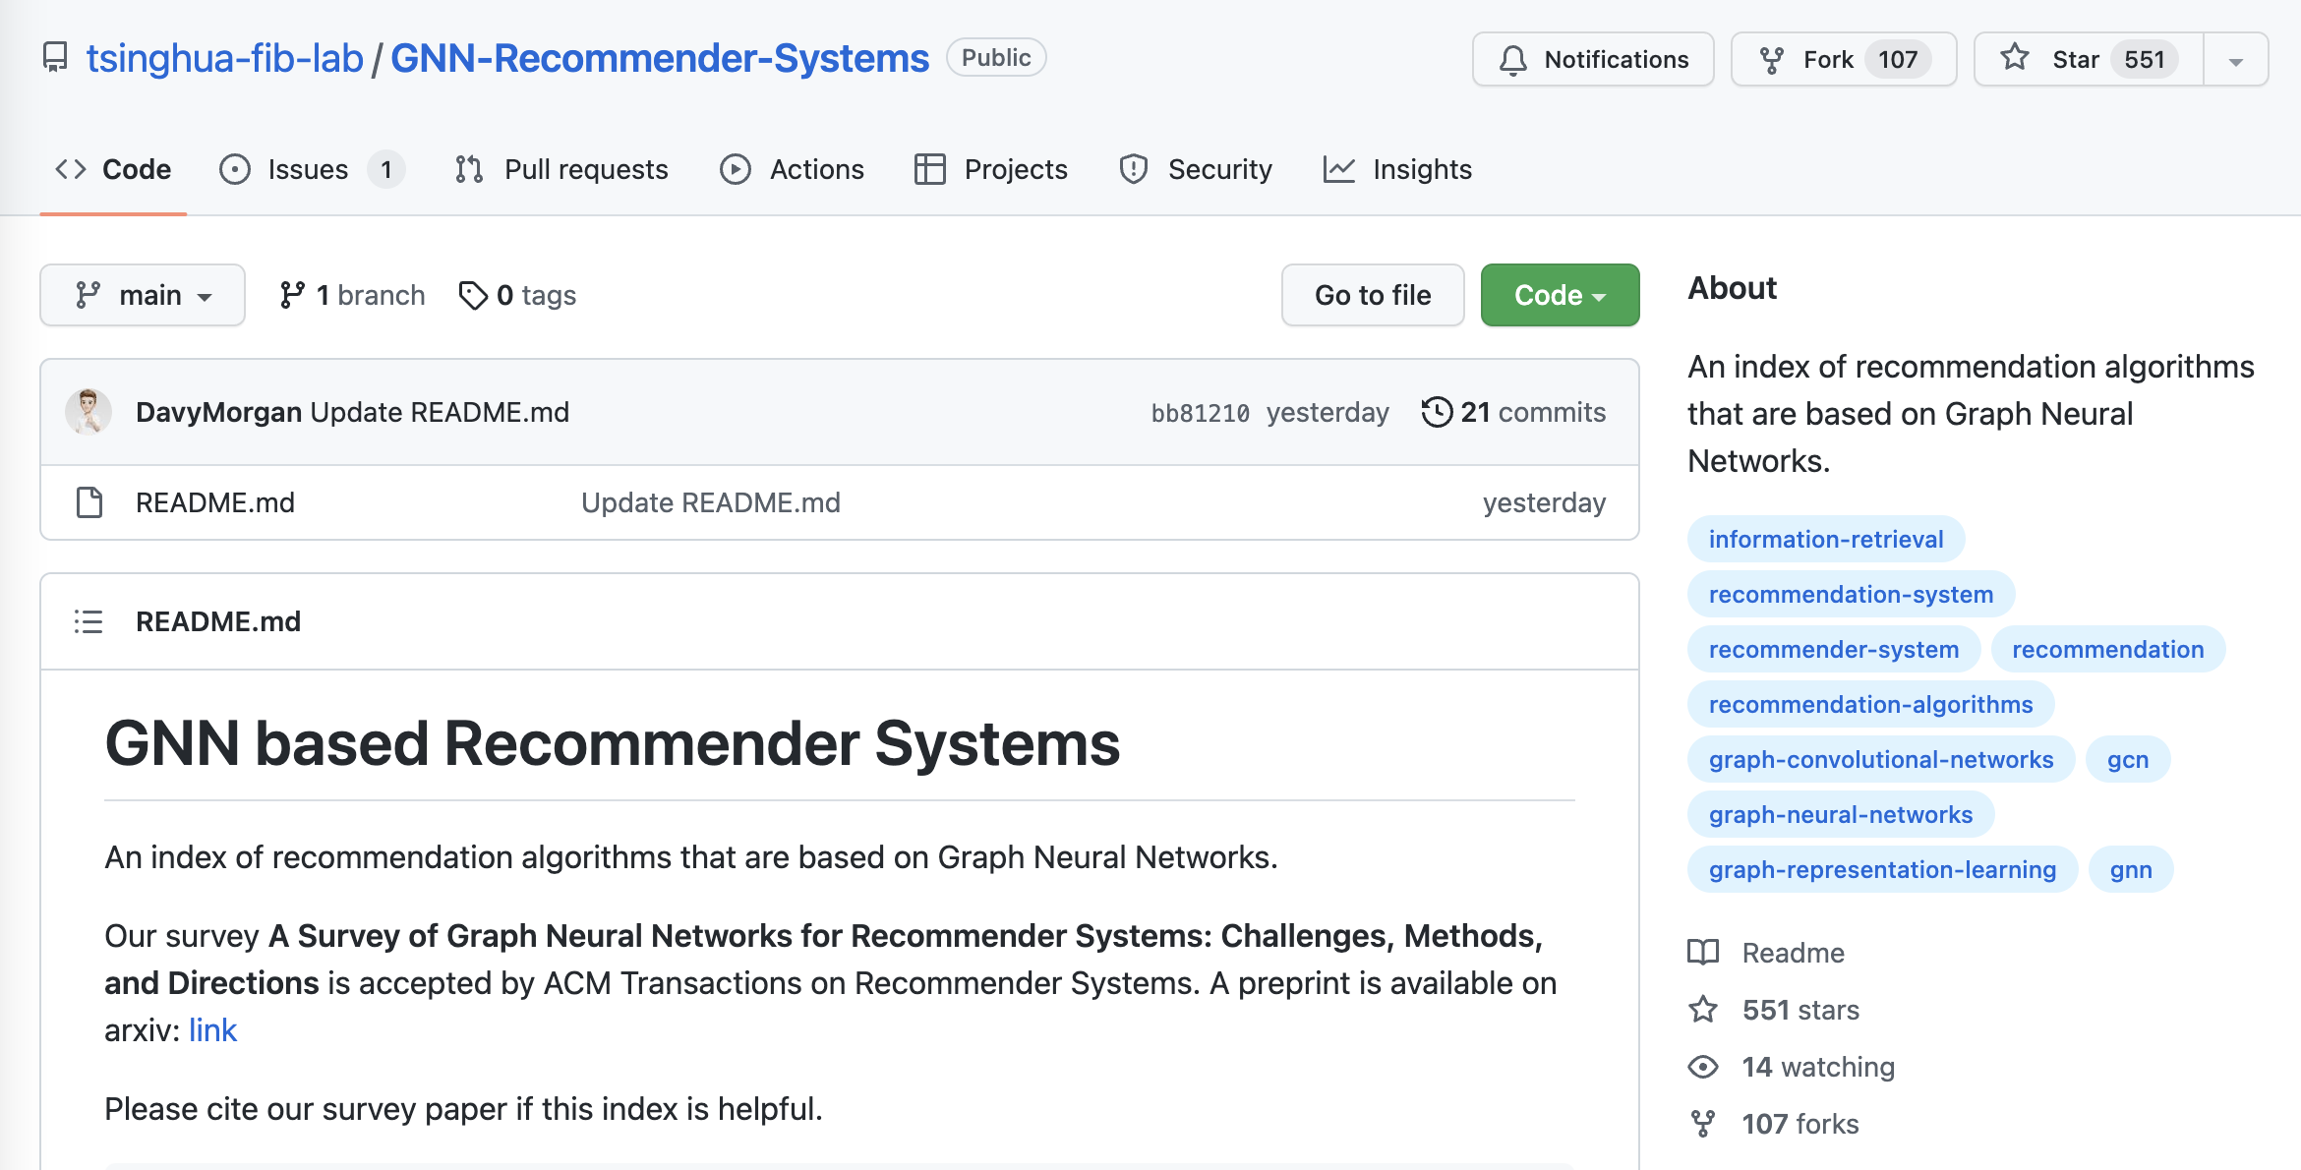
Why GNN?

Slide 15
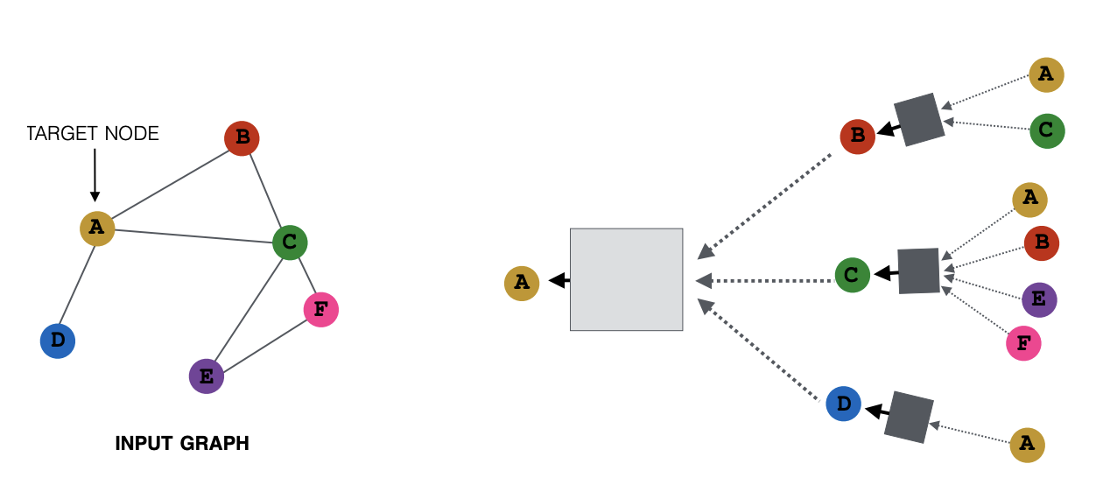

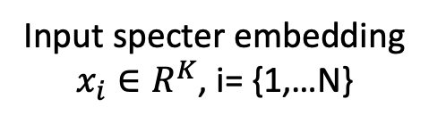

What is GNN?
Matrix Computation
Matrix Computation
Node (a paper): specter embedding
Edge: citation
Input specter embedding
$x_{i}∈R^{K}$, i= {1,…N}
Output embedding
$$x_{A}∈R^{f}$$
2-hop
Input Citation Graph
$G∈R^{N×N}$
1-hop
Ref: https://snap-stanford.github.io/cs224w-notes/machine-learning-with-networks/graph-neural-networks

Slide 16
Challenge Scale Data Parallelism v.s. Gsplit Parallelism
Proposed
Today’s data parallelism (e.g., DGL, PaGraph)
Proposed split parallelism (Gsplit)
Standard
Data parallelism – too much communication
Split parallelism (Proposed)

Slide 17
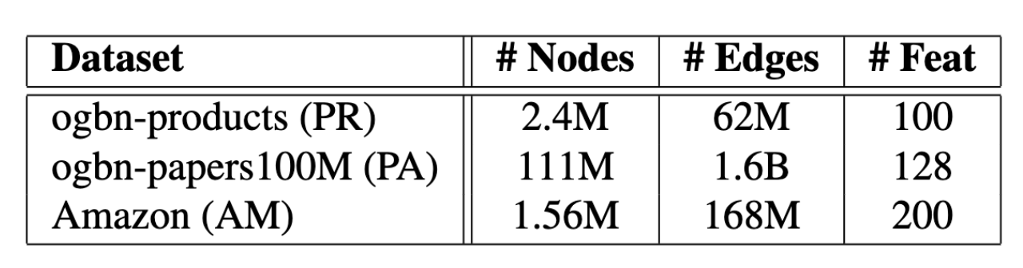
Gsplit is Faster
Today’s data parallelism (e.g., DGL, PaGraph)
Proposed split parallelism (Gsplit)

Slide 18
Tutorial Background
Metcalfe’s Law
Deep Nets
Pre-training
Fine-Tuning
Inference
Specter
GNNs
Approximate Nearest Neighbors
Graphs
Random Walks
Shortest Paths
Linear Algebra
SVDs
Latent Semantic Indexing
Laplacians
ProNE

Slide 19
Approximate Nearest Neighbors in External Memory
Kenneth Church

Slide 20
Opportunity for Publication
Well established:
Memory resident solutions (annoy)
Novelty:
External memory
mmap
Embarrassingly parallel
Standard evaluation benchmark
https://ann-benchmarks.com/
May not address advantages of proposed solution
Indexing time: small memory footprint during indexing, embarrassingly parallel
Inference time: small memory footprint, quick startup

Slide 21
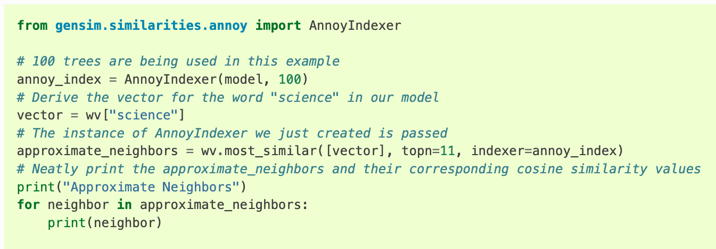
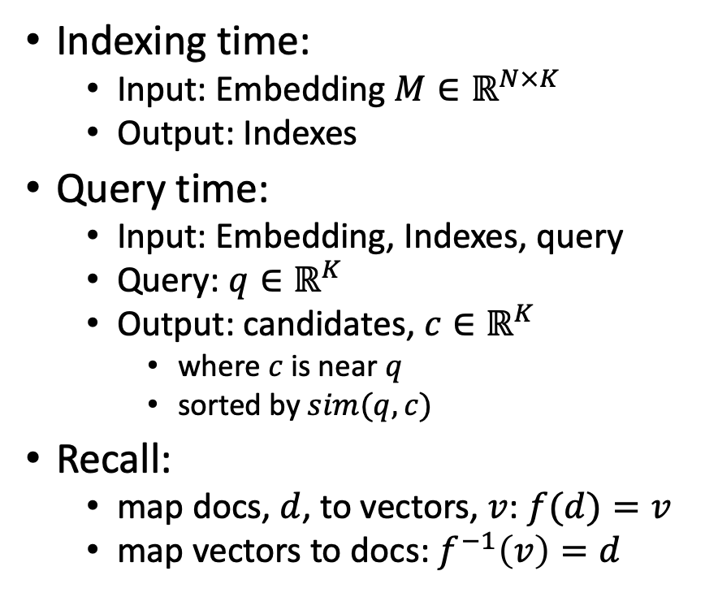
Processing with Embeddings: Annoy / Faiss Approximate Nearest Neighbors (ANN)
Indexing time:
Input: Embedding $M∈ℝ^{N×K}$
Output: Indexes
Query time:
Input: Embedding, Indexes, query
Query: $q∈ℝ^{K}$
Output: candidates, $c∈ℝ^{K}$
where $c$ is near $q$
sorted by $sim(q,c)$
Recall:
map docs, $d$, to vectors, $v$: $f(d)=v$
map vectors to docs: $f^{−1}\left(v\right)=d$
https://radimrehurek.com/gensim/auto_examples/tutorials/run_annoy.html

Slide 22
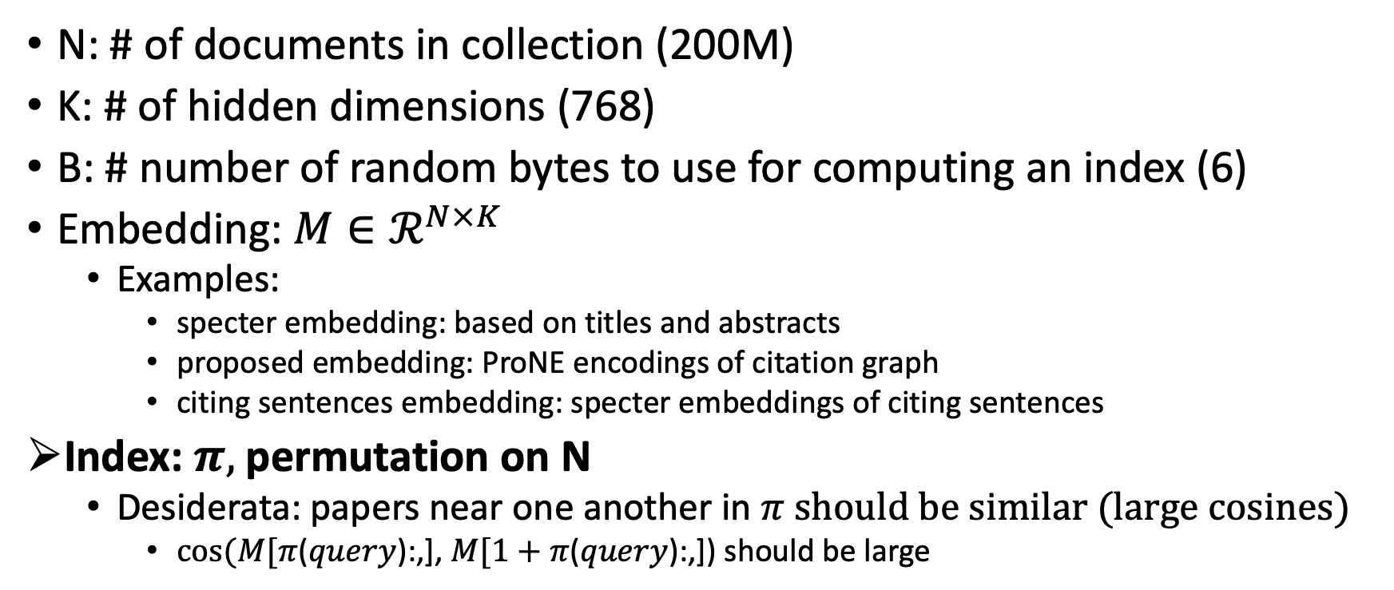
Notation
N: # of documents in collection (200M)
K: # of hidden dimensions (768)
B: # number of random bytes to use for computing an index (6)
Embedding: $M∈ℛ^{N×K}$
Examples:
specter embedding: based on titles and abstracts
proposed embedding: ProNE encodings of citation graph
citing sentences embedding: specter embeddings of citing sentences
Index: $π,$permutation on N
Desiderata: papers near one another in $π$ should be similar (large cosines)
$cos⁡(M[π$($query$):,], $M[1+π$($query$):,]) should be large

Slide 23
Memory Mapping (mmap)
Very useful function in C
floats = (float *)mmapfile(av[++i], &nfloats);
nfloats /= sizeof(float);
Loads a large file (embedding) quickly
by adding file on disk to page table (without copying the contents)
returns a pointer to the contents (and the size of object in bytes)
If you dereference a pointer to virtual memory,
there could be a page fault (if the page is not in physical memory)

Slide 24
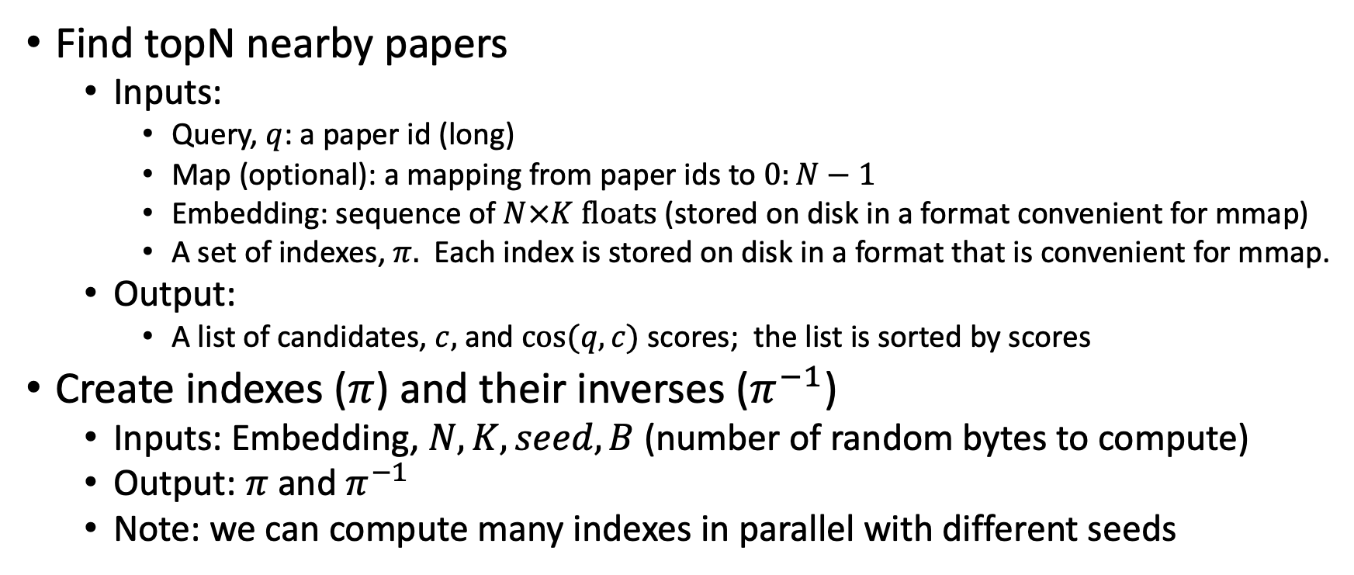
Problems to be done in external memory (Avoid loading embedding into memory)
Find topN nearby papers
Inputs:
Query, $q$: a paper id (long)
Map (optional): a mapping from paper ids to $0:N−1$
Embedding: sequence of $N×K floats$ (stored on disk in a format convenient for mmap)
A set of indexes, $π.$ Each index is stored on disk in a format that is convenient for mmap.
Output:
A list of candidates, $c,$ and $cos⁡(q,c)$ scores; the list is sorted by scores
Create indexes ($π$) and their inverses ($π^{−1}$)
Inputs: Embedding, $N, K, seed, B$(number of random bytes to compute)
Output: $π$ and $π^{−1}$
Note: we can compute many indexes in parallel with different seeds

Slide 25

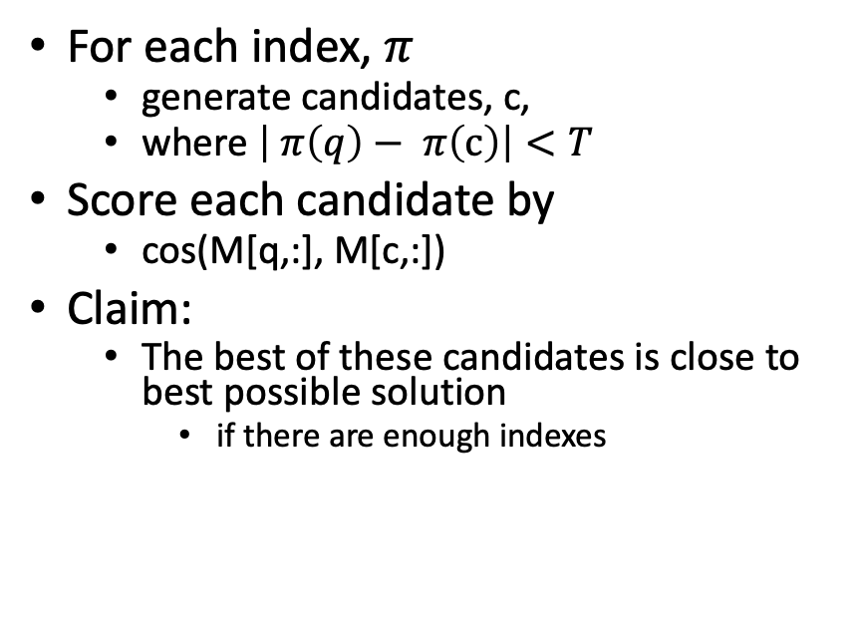
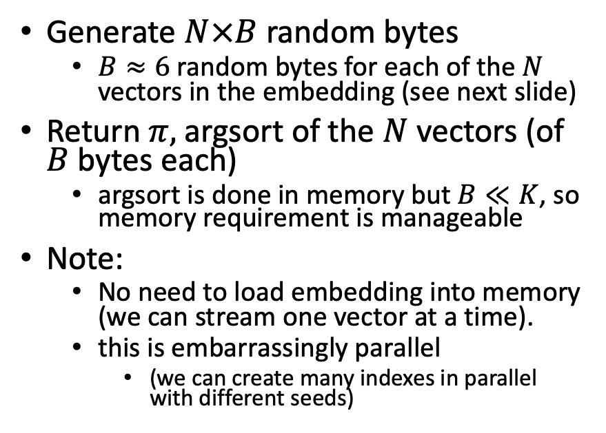
Solutions
Find topN nearby papers (easy)
Create index $π$
For each index, $π$
generate candidates, c,
where $\left| π\left(q\right)− π\left(c\right)\right|<T$
Score each candidate by
cos(M[q,:], M[c,:])
Claim:
The best of these candidates is close to best possible solution
if there are enough indexes
Generate $N×B$ random bytes
$B≈6$ random bytes for each of the $N$ vectors in the embedding (see next slide)
Return $π,$argsort of the $N$vectors (of $B$ bytes each)
argsort is done in memory but $B≪K$, so memory requirement is manageable
Note:
No need to load embedding into memory (we can stream one vector at a time).
this is embarrassingly parallel
(we can create many indexes in parallel with different seeds)

Slide 26
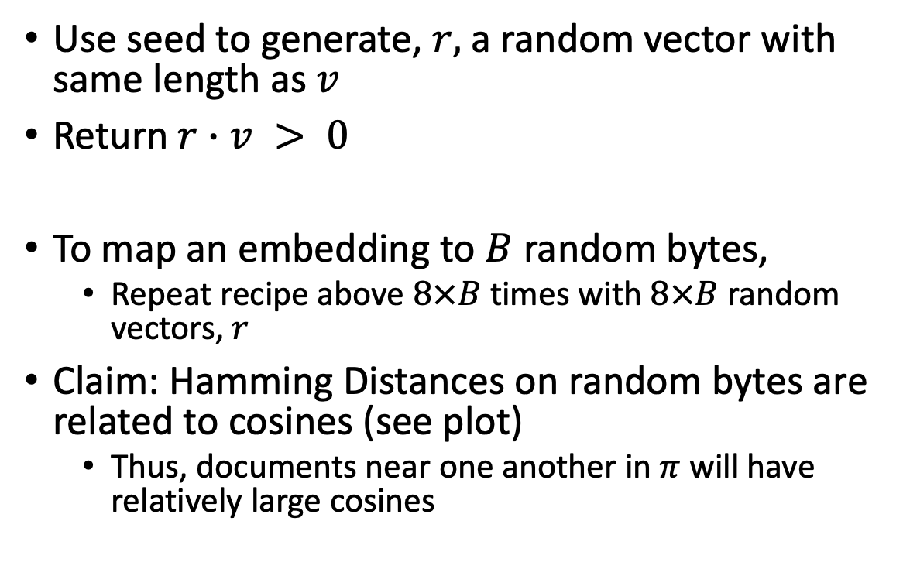

Method for mapping vector, $v$, to 1 bit
Use seed to generate, $r,$ a random vector with same length as $v$
Return $r∙v > 0$
To map an embedding to $B$ random bytes,
Repeat recipe above $8×B$ times with $8×B$ random vectors, $r$
Claim: Hamming Distances on random bytes are related to cosines (see plot)
Thus, documents near one another in $π$ will have relatively large cosines

Slide 27


Claim: $π$ brings similar docs near one another
Since $π$ is sorted by $B$ random bytes,
Documents near one another in $π$ will have
relatively small Hamming Distances
and relatively large cosines

Slide 28


Docs near one another in $π$ are more similar
Index ($π$)
Random Baseline (without index)
Hamming Cosine N
0 0.986 245,277
1 0.925 36,590
2 0.893 37,459
3 0.865 37,306
4 0.840 35,855
5 0.818 32,184
6 0.796 27,423
7 0.776 22.319
8 0.757 17,681
9 0.738 13,138
Hamming Cosine N
0 0.999 3,955
1 0.967 879
2 0.938 1,647
3 0.912 2,239
4 0.891 5,401
5 0.883 5,853
6 0.852 9,606
7 0.826 14,087
8 0.804 22,566
9 0.782 35,174

Slide 29
Pointers to Code based on ANN
Environment variables
query=232040593
JSALTdir=/work/k.church/JSALT-2023/
JSALTsrc=/work/k.church/githubs/JSALT_Better_Together/src
specter=$JSALTdir/semantic_scholar/embeddings/specter
proposed=$JSALTdir/semantic_scholar/embeddings/proposed
Find 5 papers near query (using both Specter and Proposed)
$JSALTsrc/near.sh $query 5
Under the covers
# Find 10 papers near query (using specter embedding)
echo $query | $JSALTsrc/C/near_with_floats --dir $specter $specter/map $specter/idx.*.i > /tmp/near.specter
cut -f1,3 < /tmp/near.specter | sort -nr -u | head
# Same as above, but replace specter embedding with proposed embedding
echo $query | $JSALTsrc/C/near_with_floats --dir $proposed $proposed/idx.*.i > /tmp/near.proposed
cut -f1,3 < /tmp/near.proposed | sort -nr -u | head

Slide 30
Pointers to C Code: $JSALTsrc/C/
near_with_floats:
input query (corpusId)
output corpusIds
vector_near_with_floats:
input vector
output corpusId
pairs_to_cos:
input pairs of corpusIds
output cos scores
id_to_floats:
input corpusId
output vectors

Slide 31
Tutorial Background
Metcalfe’s Law
Deep Nets
Pre-training
Fine-Tuning
Inference
Specter
GNNs
Approximate Nearest Neighbors
Graphs
Random Walks
Shortest Paths
Linear Algebra
SVDs
Latent Semantic Indexing
Laplacians
ProNE

Slide 32
Bellcore’s Example: Bag of Words + SVD http://wordvec.colorado.edu/papers/Deerwester_1990.pdf
c1 Human machine interface for Lab ABC computer applications
c2 A survey of user opinion of computer system response time
c3 The EPS user interface management system
c4 System and human system engineering testing of EPS
c5 Relation of user-perceived response time to error measurement
m1 The generation of random, binary, unordered trees
m2 The intersection graph of paths in trees
m3 Graph minors IV: Widths of trees and well-quasi-ordering
m4 Graph minors: A survey

Slide 33
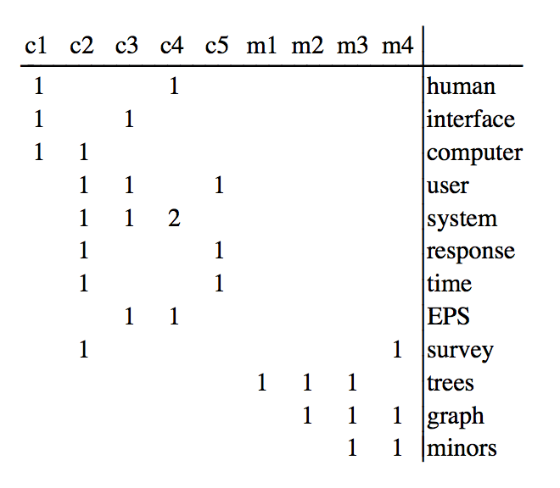
Term by Document Matrix

Slide 34
Dimension Reduction in R
"bellcore"<-
structure(.Data = c(1, 1, 1, 0, 0, 0, 0, 0, 0, 0, 0, 0, 0, 0, 1, 1, 1, 1,
1, 0, 1, 0, 0, 0, 0, 1, 0, 1, 1, 0, 0, 1, 0, 0, 0, 0, 1, 0, 0, 0, 2, 0,
0, 1, 0, 0, 0, 0, 0, 0, 0, 1, 0, 1, 1, 0, 0, 0, 0, 0, 0, 0, 0, 0, 0,
0, 0, 0, 0, 1, 0, 0, 0, 0, 0, 0, 0, 0, 0, 0, 0, 1, 1, 0, 0, 0, 0, 0,
0, 0, 0, 0, 0, 1, 1, 1, 0, 0, 0, 0, 0, 0, 0, 0, 1, 0, 1, 1),
.Dim = c(12, 9),
.Dimnames = list(c("human", "interface", "computer", "user",
"system", "response", "time", "EPS", "survey", "trees", "graph",
"minors"),
c("c1", "c2", "c3", "c4", "c5", "m1", "m2", "m3", "m4")))
b = svd(bellcore)
b2 = b$u[,1:2] %*% diag(b$d[1:2]) %*% t(b$v[,1:2])
dimnames(b2) = dimnames(bellcore)
par(mfrow=c(2,2))
plot(hclust(as.dist(-cor(bellcore))))
plot(hclust(as.dist(-cor(t(bellcore)))))
plot(hclust(as.dist(-cor(b2))))
plot(hclust(as.dist(-cor(t(b2)))))

Slide 35
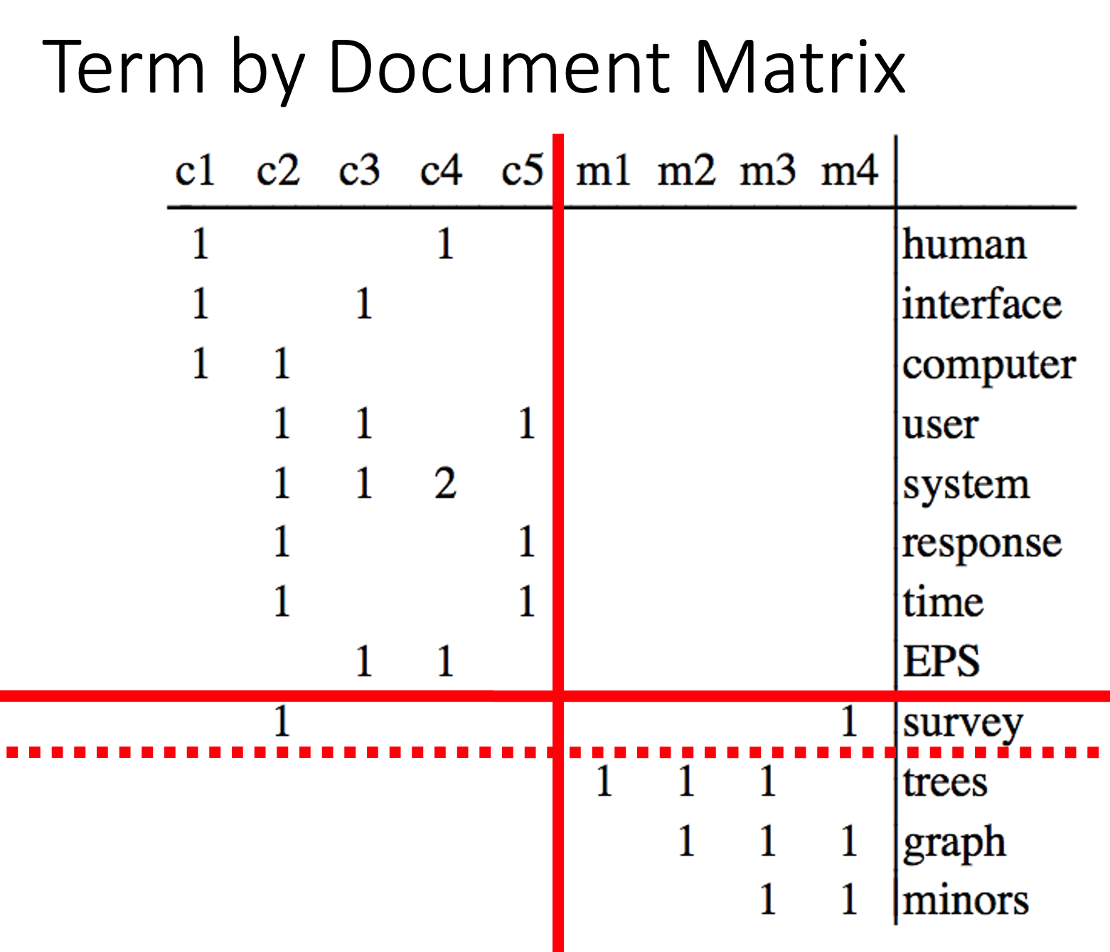
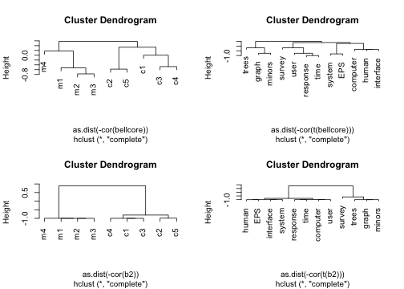
b = svd(bellcore)
b2 = b$u[,1:2] %*% diag(b$d[1:2]) %*% t(b$v[,1:2])
dimnames(b2) = dimnames(bellcore)
par(mfrow=c(2,2))
plot(hclust(as.dist(-cor(bellcore))))
plot(hclust(as.dist(-cor(t(bellcore)))))
plot(hclust(as.dist(-cor(b2))))
plot(hclust(as.dist(-cor(t(b2)))))

Slide 36
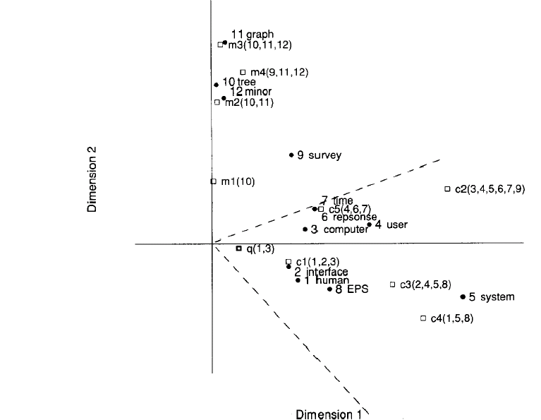
Latent concept vector space
• term
document
query
--- cosine > 0.9

Slide 37
Tutorial Background
Metcalfe’s Law
Deep Nets
Pre-training
Fine-Tuning
Inference
Specter
GNNs
Approximate Nearest Neighbors
Graphs
Random Walks
Shortest Paths
Linear Algebra
SVDs
Latent Semantic Indexing
Laplacians
ProNE

Slide 38
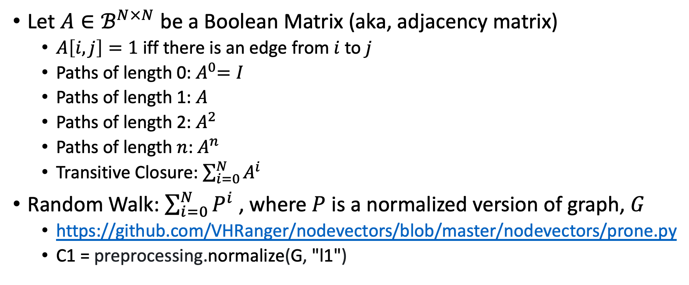
Random Walks
Let $A∈ℬ^{N×N}$ be a Boolean Matrix (aka, adjacency matrix)
$A\left[i,j\right]=1$ iff there is an edge from $i$ to $j$
Paths of length 0:${ A}^{0}=I$
Paths of length 1: $A$
Paths of length 2: $A^{2}$
Paths of length $n$: $A^{n}$
Transitive Closure: $\sum_{i=0}^{N}{A^{i}}$
Random Walk: $\sum_{i=0}^{N}{P^{i}}$ , where $P$ is a normalized version of graph, $G$
https://github.com/VHRanger/nodevectors/blob/master/nodevectors/prone.py
C1 = preprocessing.normalize(G, "l1")

Slide 39
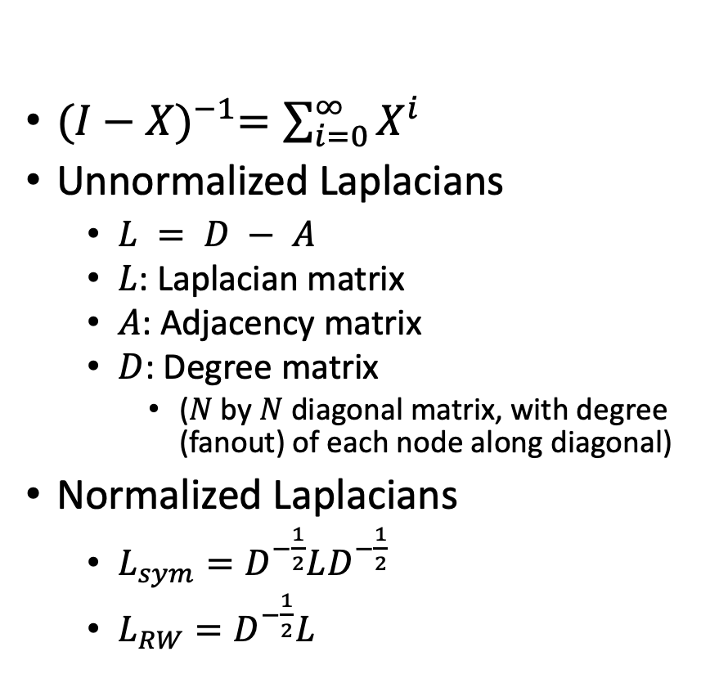
Graph Laplacians https://www.cs.mcgill.ca/~wlh/grl_book/files/GRL_Book.pdf
${(I−X)}^{−1}=\sum_{i=0}^{∞}{X^{i}}$
Unnormalized Laplacians
$L = D − A$
$L$: Laplacian matrix
$A$: Adjacency matrix
$D$: Degree matrix
($N$ by $N$ diagonal matrix, with degree (fanout) of each node along diagonal)
Normalized Laplacians
$L_{sym}=D^{−\frac{1}{2}}LD^{−\frac{1}{2}}$
$L_{RW}=D^{−\frac{1}{2}}L$
Applications of Laplacians
There are connections with
Graph Cuts
Spectral Clustering
Random Walks

Slide 40
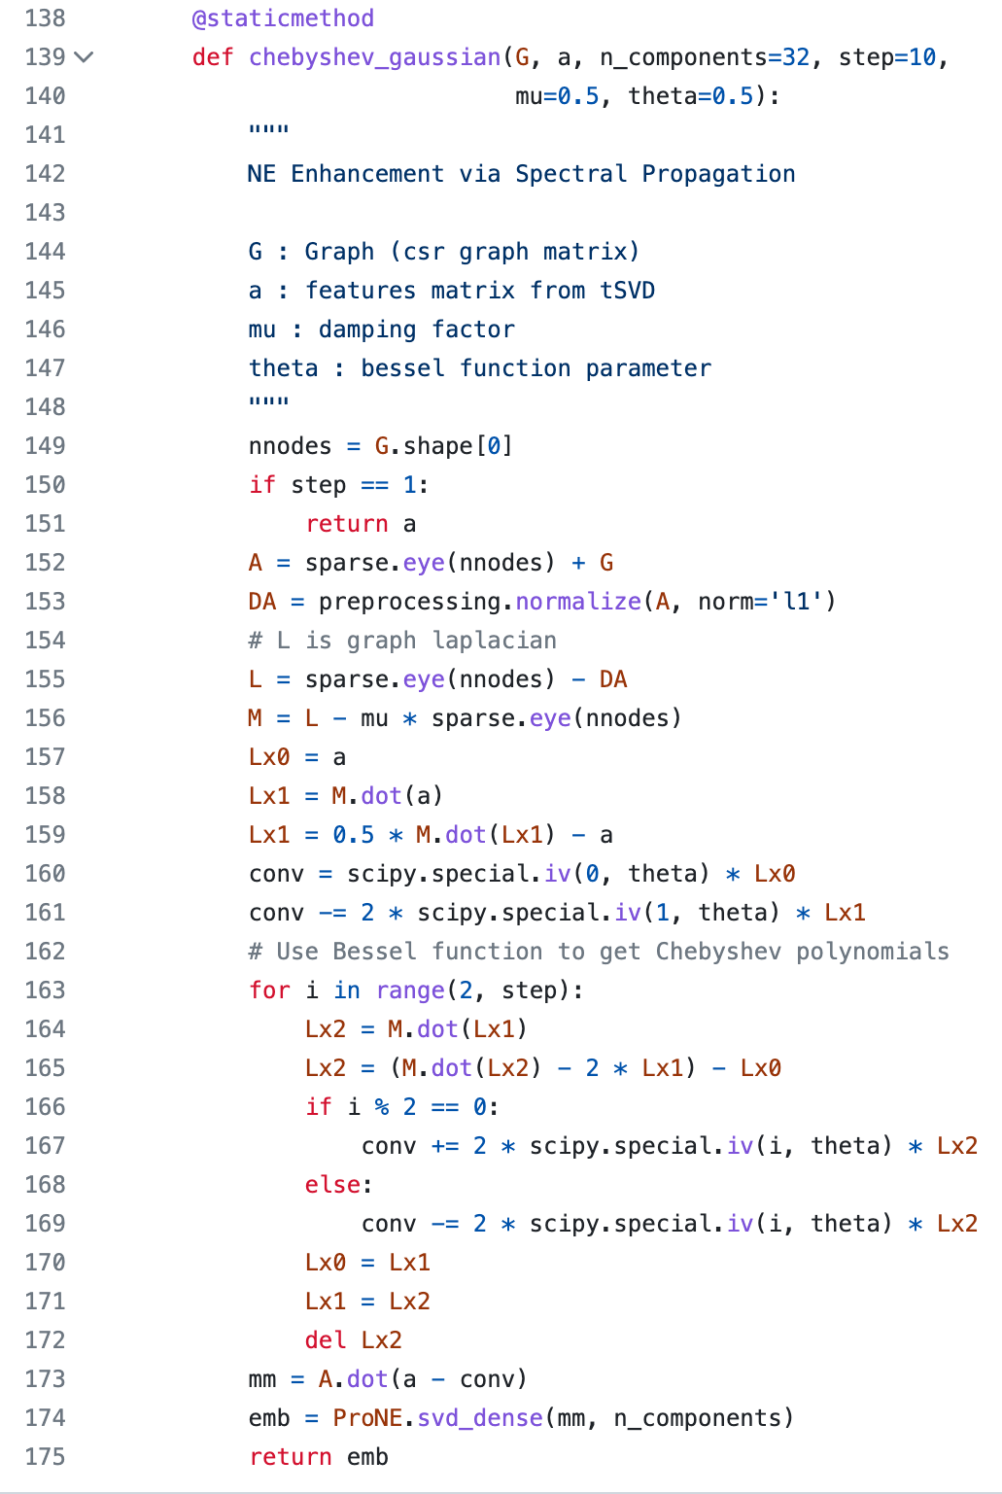
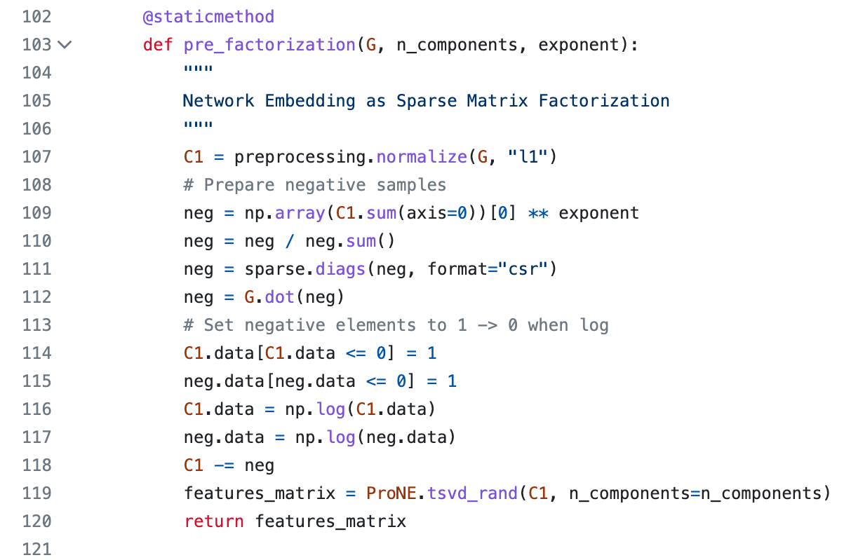
ProNE (Linear Algebra) https://github.com/VHRanger/nodevectors/blob/master/nodevectors/prone.py
Sparse
Prefactorization
Dense: N by K
Sparse
Chebyshev
Dense: N by K
Dense: N by K
Dense: N by K
Dense: N by K
Dense: N by K
Dense: N by K
Sparse
Dense: N by K

Slide 41
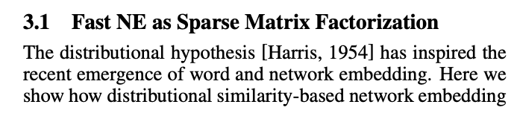
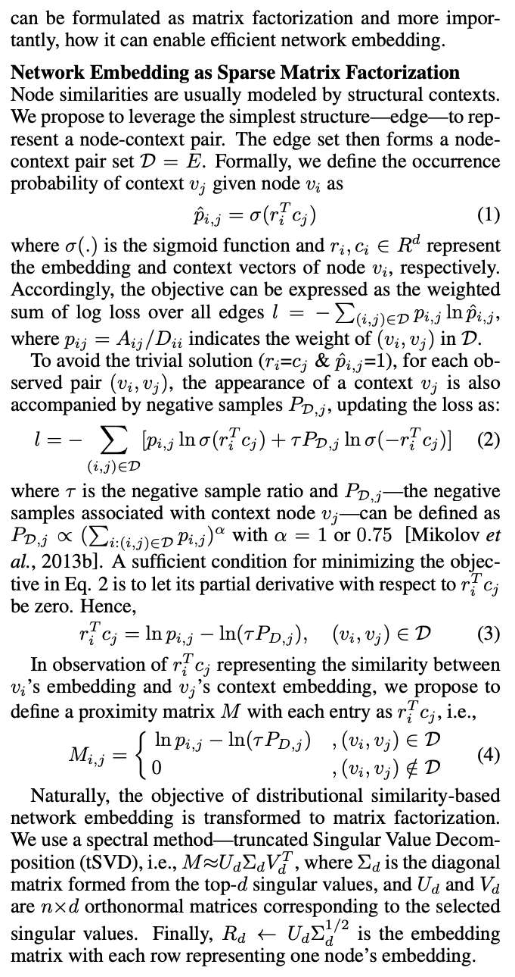
ProNE (Linear Algebra) https://github.com/VHRanger/nodevectors/blob/master/nodevectors/prone.py
Prefactorization
Paper

Slide 42
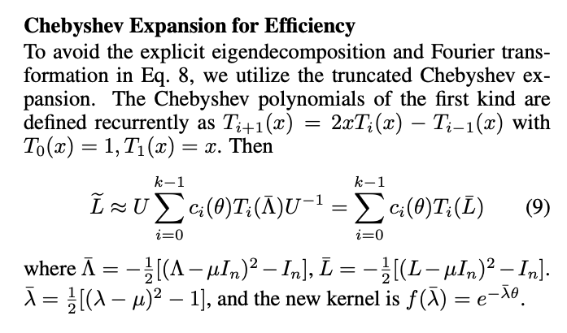
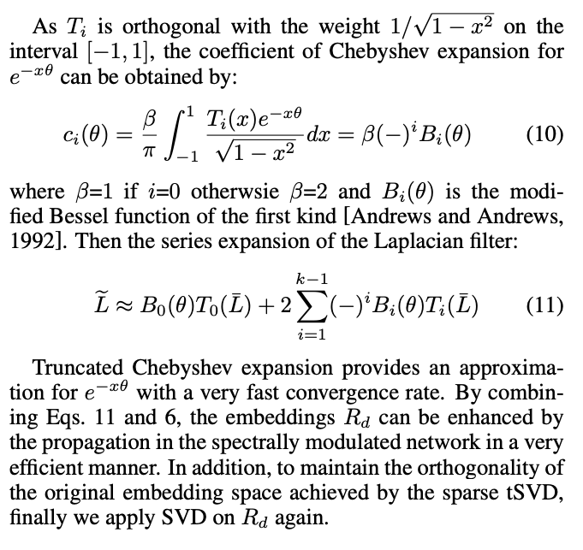
Paper
Chebyshev
Eqn (11)

Slide 43
Asks
Theory: Exactly what is ProNE computing?
How does the final embedding relate to distances in graph?
What is the Chebyshev approximating?
Systems: Speedups
I have separated prefactoring and each step in the loop into separate slurm jobs to support checkpointing.
We have constraints on time and memory on our cluster
Prefactoring uses less memory than Chebyshev
Because there are fewer dense matrices
Calling garbage collector can remove some large dense matrices
Are there opportunities for multi-threading, GPUs, C, cuda, tiling matrices?

Slide 44
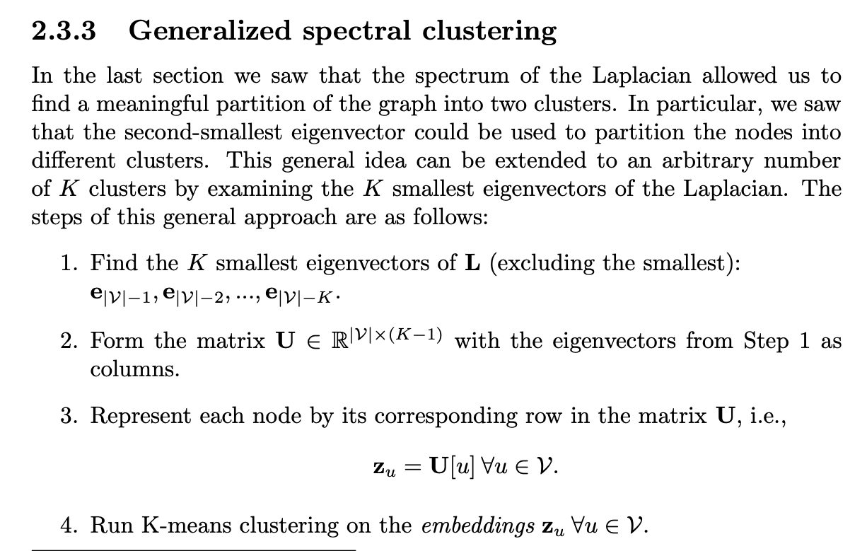
Laplacians and Spectral Clustering https://www.cs.mcgill.ca/~wlh/grl_book/files/GRL_Book.pdf
K-means is useful on many embeddings
(Specter)

Slide 45

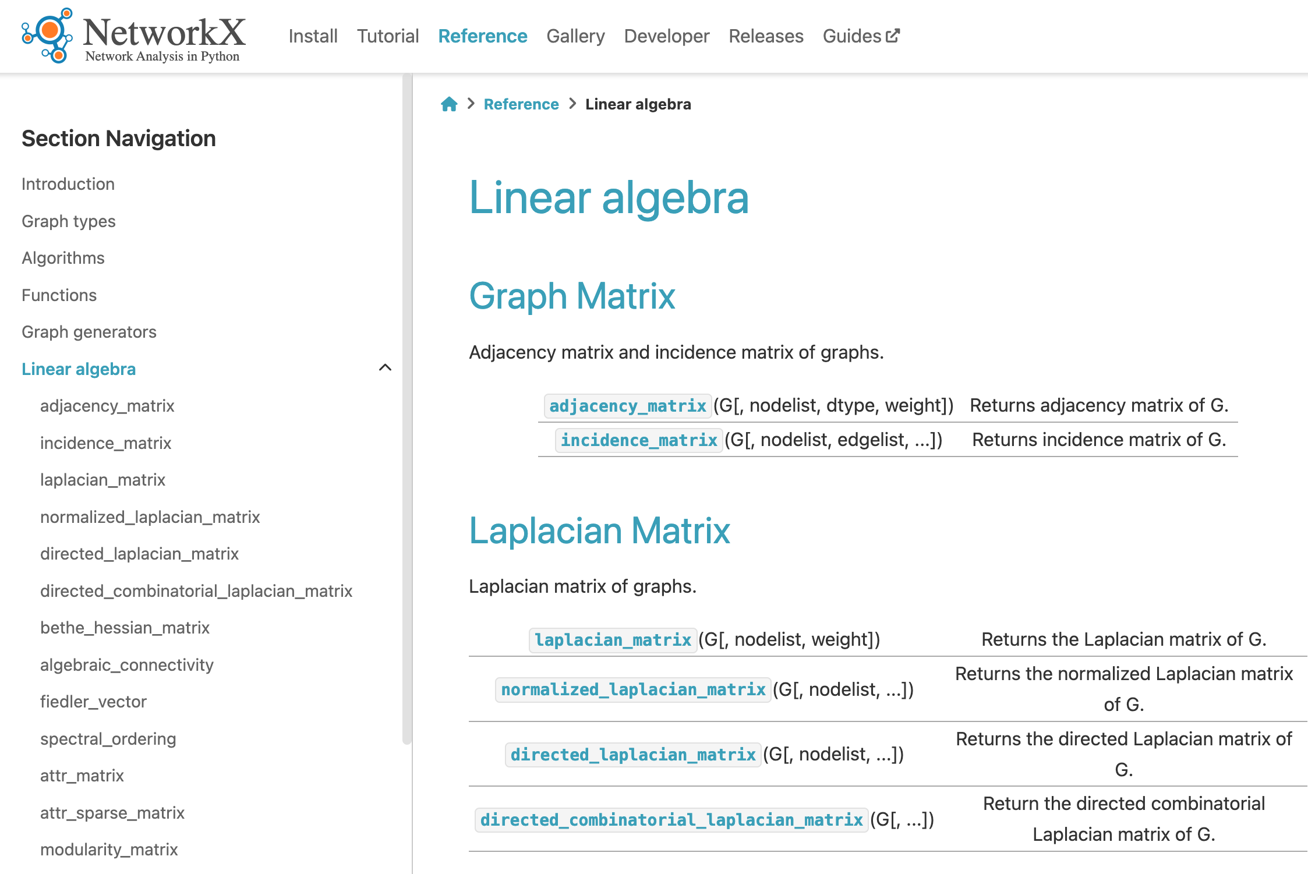
Topics to Cover
Clustering
K-means
sklearn
Graph Cuts, RatioCut, Diameter, Conductance
Sparse matrix packages:
scipy.sparse
networkx
https://networkx.org/documentation/stable/reference/linalg.html

Slide 46
Exercises (Lab for for this afternoon) https://github.com/kwchurch/JSALT_Better_Together/tree/main/doc/exercises
Simple usage of
Semantic Scholar’s API
Input: paper ids
Outputs: titles, abstracts, more ids, references, citations, embeddings
Models on HuggingFace
Input: titles + abstracts
Output: vectors (embeddings)
Dimension Reduction (Singular Value Decomposition (SVD))
Reduce BERT vectors from 768 dimensions to 2 dimensions (for plotting)
Replicate the centroid assumption
Centroid Assumption: vector of a doc is close to centroid of its references

